Slide 1
Melanoma Detection Using Deep Learning (DL)

Slide 2
Group Member: MD. FAHIM UDDIN [ ID: 1711747042 ]
NAFISA TAFSHIR [ ID: 1711029642 ]
Supervisor: DR. MOHAMMAD MONIRUJJAMAN KHAN
Associate Professor at North South University,
Ph.D. Electrical and Electronic Engineering,
The Queen Mary University of London,
UK B.Eng., Electrical and Electronic Engineering,
Queen Mary, University of London, UK.

Slide 3
Introduction
Skin cancer is an alarming disease for mankind. The necessity of early diagnosis of the skin cancer have been increased because of the rapid growth rate of Melanoma skin cancer, high treatment costs, and death rate. This cancer cells are detected manually and it takes time to cure in most of the cases. This project proposed an artificial skin cancer detection system using image processing and machine learning method. The features of the affected skin cells are extracted after the segmentation of the dermoscopic images using feature extraction technique. So we are using a deep learning based method convolutional neural network classifier for the stratification of the extracted features.

Slide 4
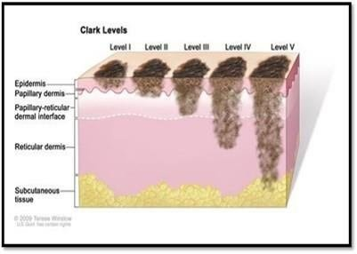
A Bit About Melanoma
Melanoma is a form of skin cancer that begins in the cells (melanocytes) that control the pigment in your skin. This illustration shows melanoma cells extending from the surface of the skin into the deeper skin layers.

Slide 5
What is Deep Learning?
Deep learning is a class of machine learning algorithms that uses multiple layers to progressively extract higher-level features from the raw input. For example, in image processing, lower layers may identify edges, while higher layers may identify the concepts relevant to a human such as digits or letters or faces.

Slide 6
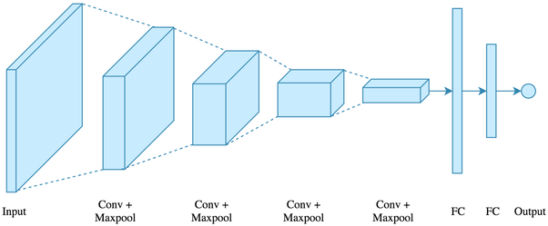
What is Convolutional Neural Networks(CNN)
A convolutional neural network (CNN) is a type of artificial neural network used in image recognition and processing that is specifically designed to process pixel data. A neural network is a system of hardware and/or software patterned after the operation of neurons in the human brain.

Slide 7
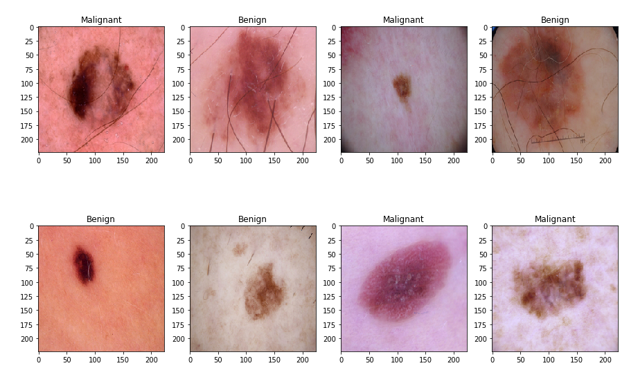
Skin Cancer Classification
A number of factors can make skin cancer recognition a challenging task. Some of these factors include flaws in image quality like uneven brightness, obstruction, and also the fact that there are many images that have a similar shape, color, and texture.

Slide 8
Proposed Method
We will use the concept of ResNet50 for classification. So, instead of starting the learning process from scratch, the model starts from patterns that have been learned when solving a different problem.

Slide 9
DataSet
We obtained a public dataset from the ISIC website for skin cancer classification. We used the ISIC Archive Downloader to download the images. We will use 3500 images for training and 1500 images for validation of size 224*224 pixels for both benign and malignant.
Link: https://tinyurl.com/isicmelanomadataset

Slide 10
Environment & Tools:
Jupyter Notebook/ Google Colab
Scikit-image
Numpy
Matplotlib
Pandas
Scikit-learn
Keras
ResNet50

Slide 11
ResNet50
ResNet 50 architecture will train on our dataset by fine-tuning across all layers and replacing top layers with one average pooling, one fully connected, and finally, the softmax layer allowing the classification of 2 diagnostic categories. The size of input images will be all resized to (224, 224) to be compatible with this model. The learning rate was set to 0.0001. It uses identity mapping to map the inputs. This identity mapping does not have any parameters and is just there to add the output from the previous layer to the layer ahead. This results in the ability to train much deeper networks..

Slide 12
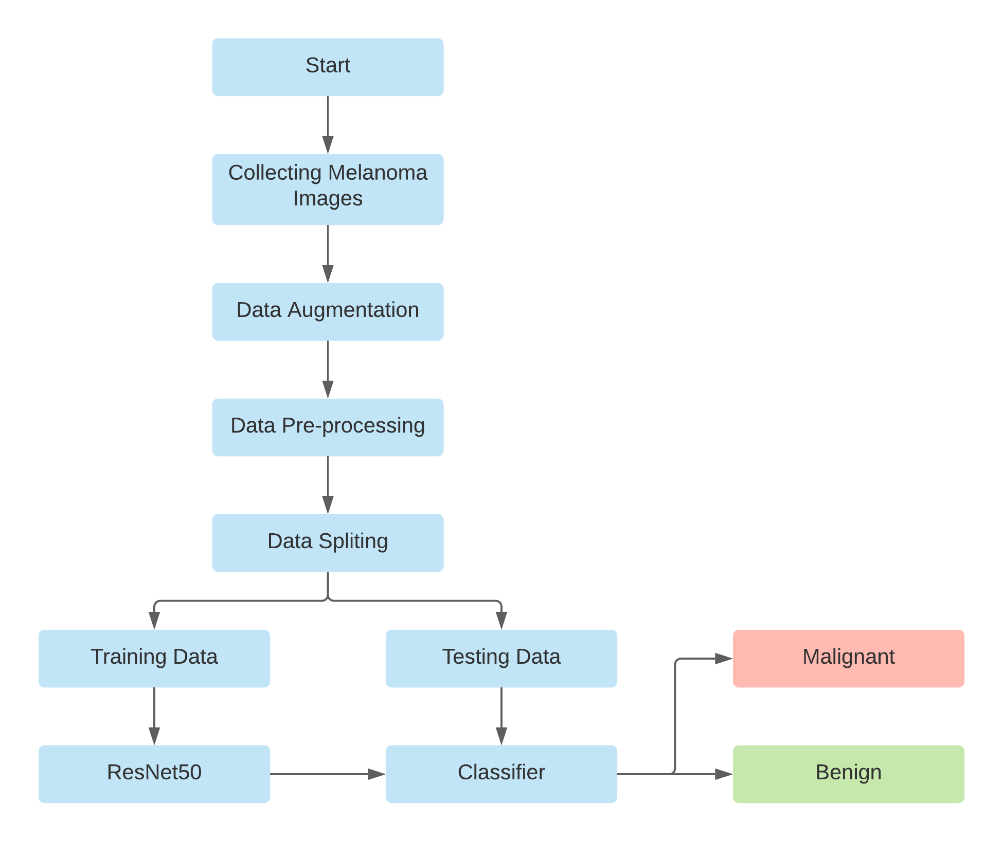
Proposed
Model
Skill A
90%
Skill B
85%
Skill C
83%
Skill D
65%

Slide 13
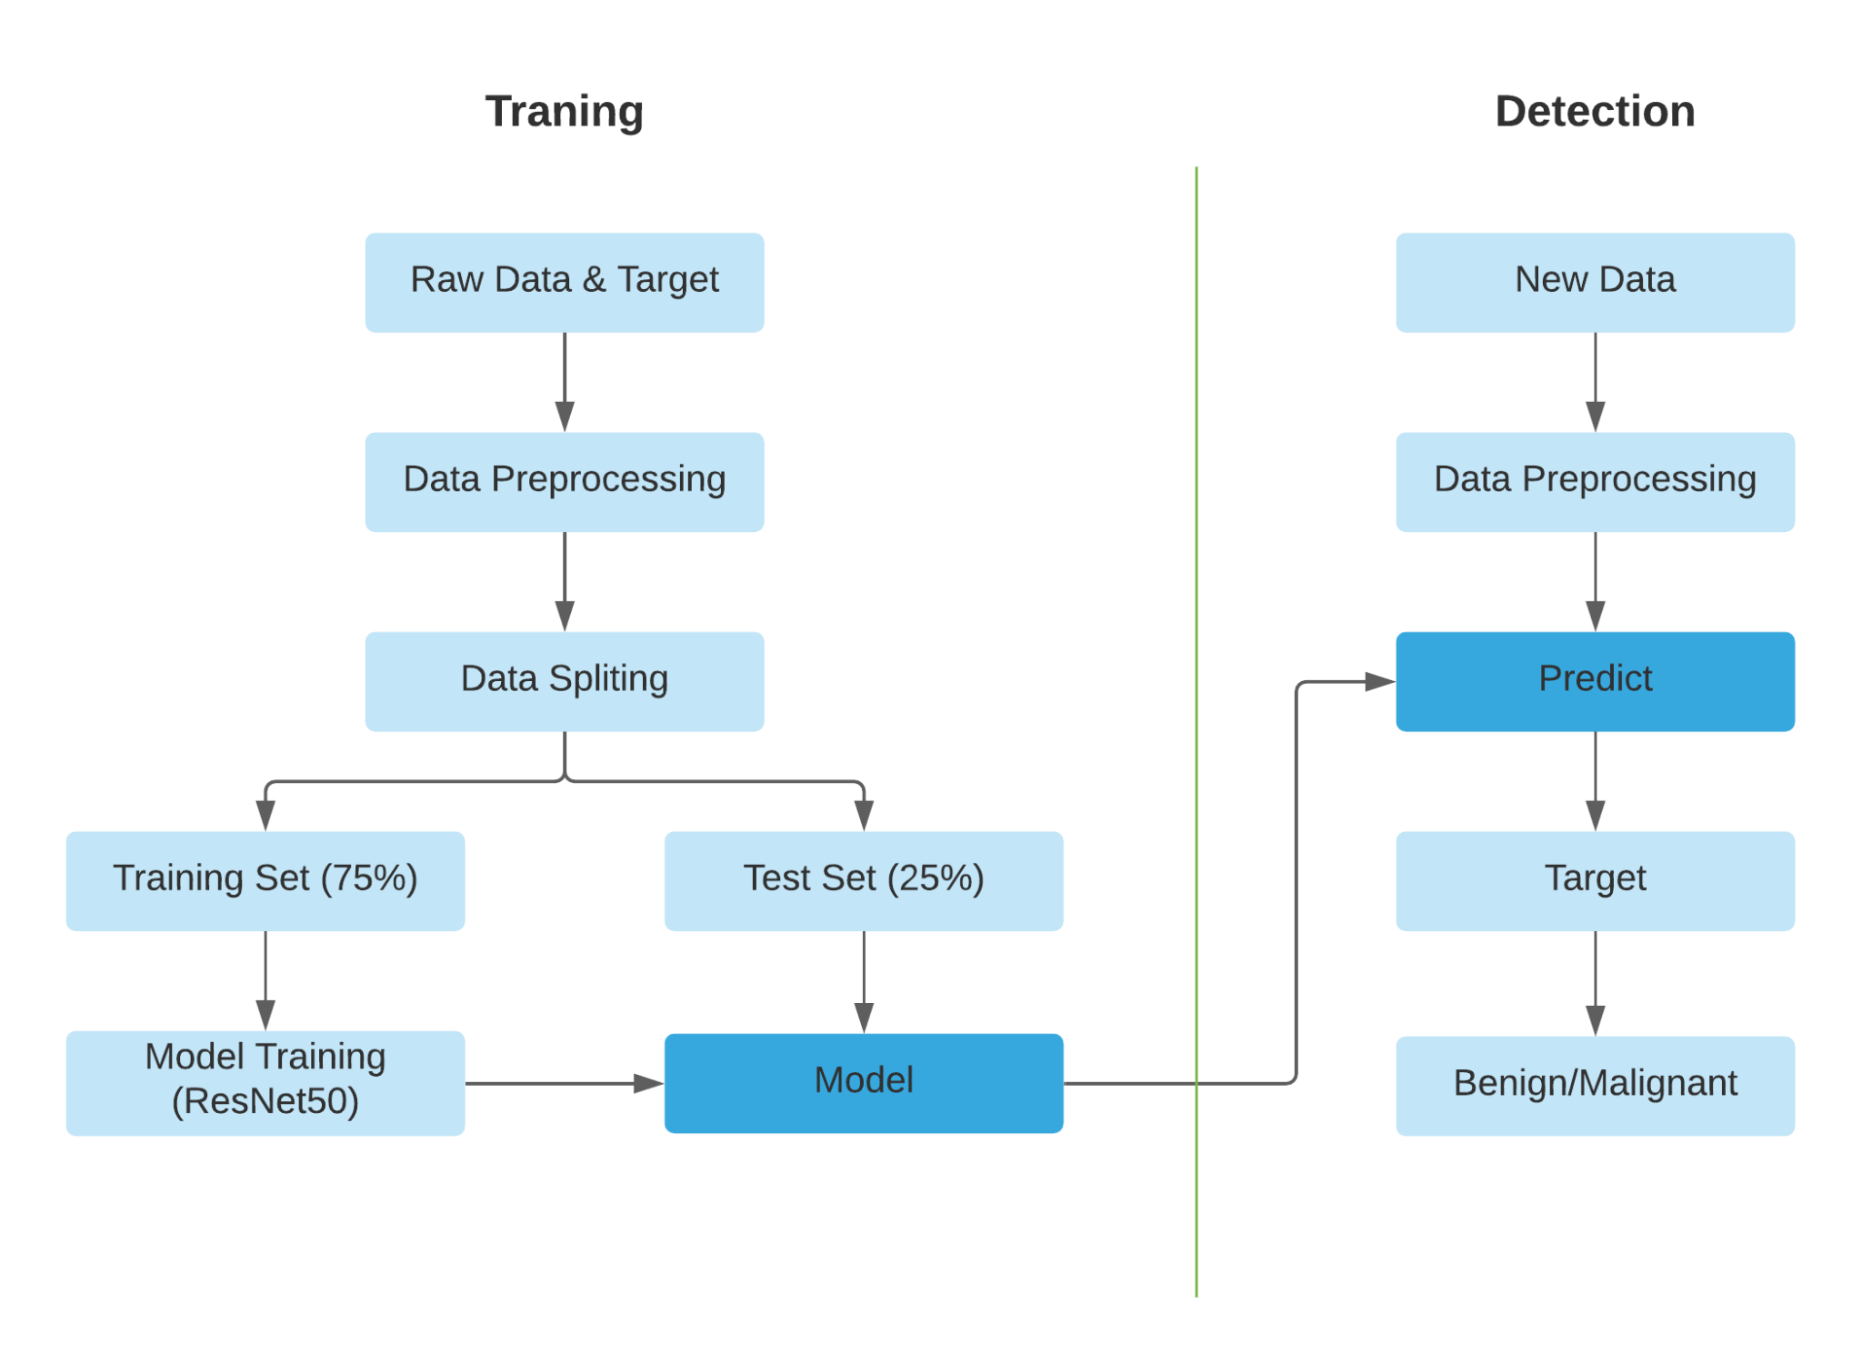
Proposed
Solution
Skill A
90%
Skill B
85%
Skill C
83%
Skill D
65%

Slide 14
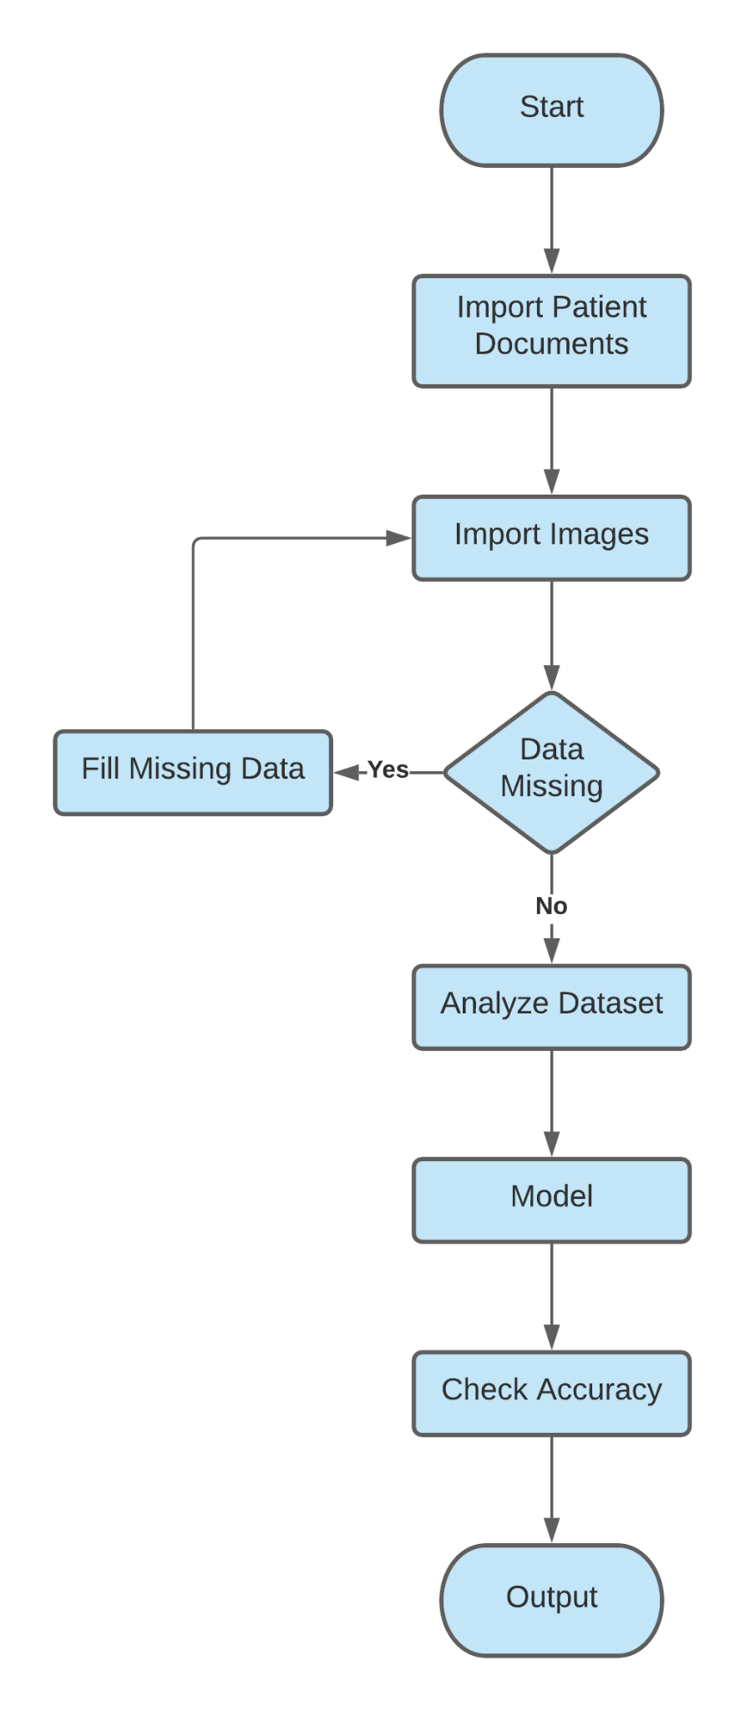
System
Flowchart
Skill A
90%
Skill B
85%
Skill C
83%
Skill D
65%

Slide 15
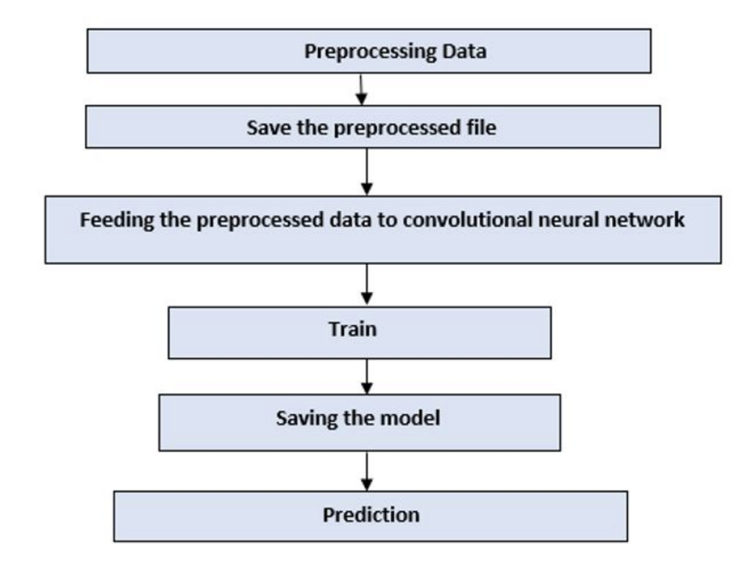
Process Flowchart
Skill A
90%
Skill B
85%
Skill C
83%
Skill D
65%

Slide 16
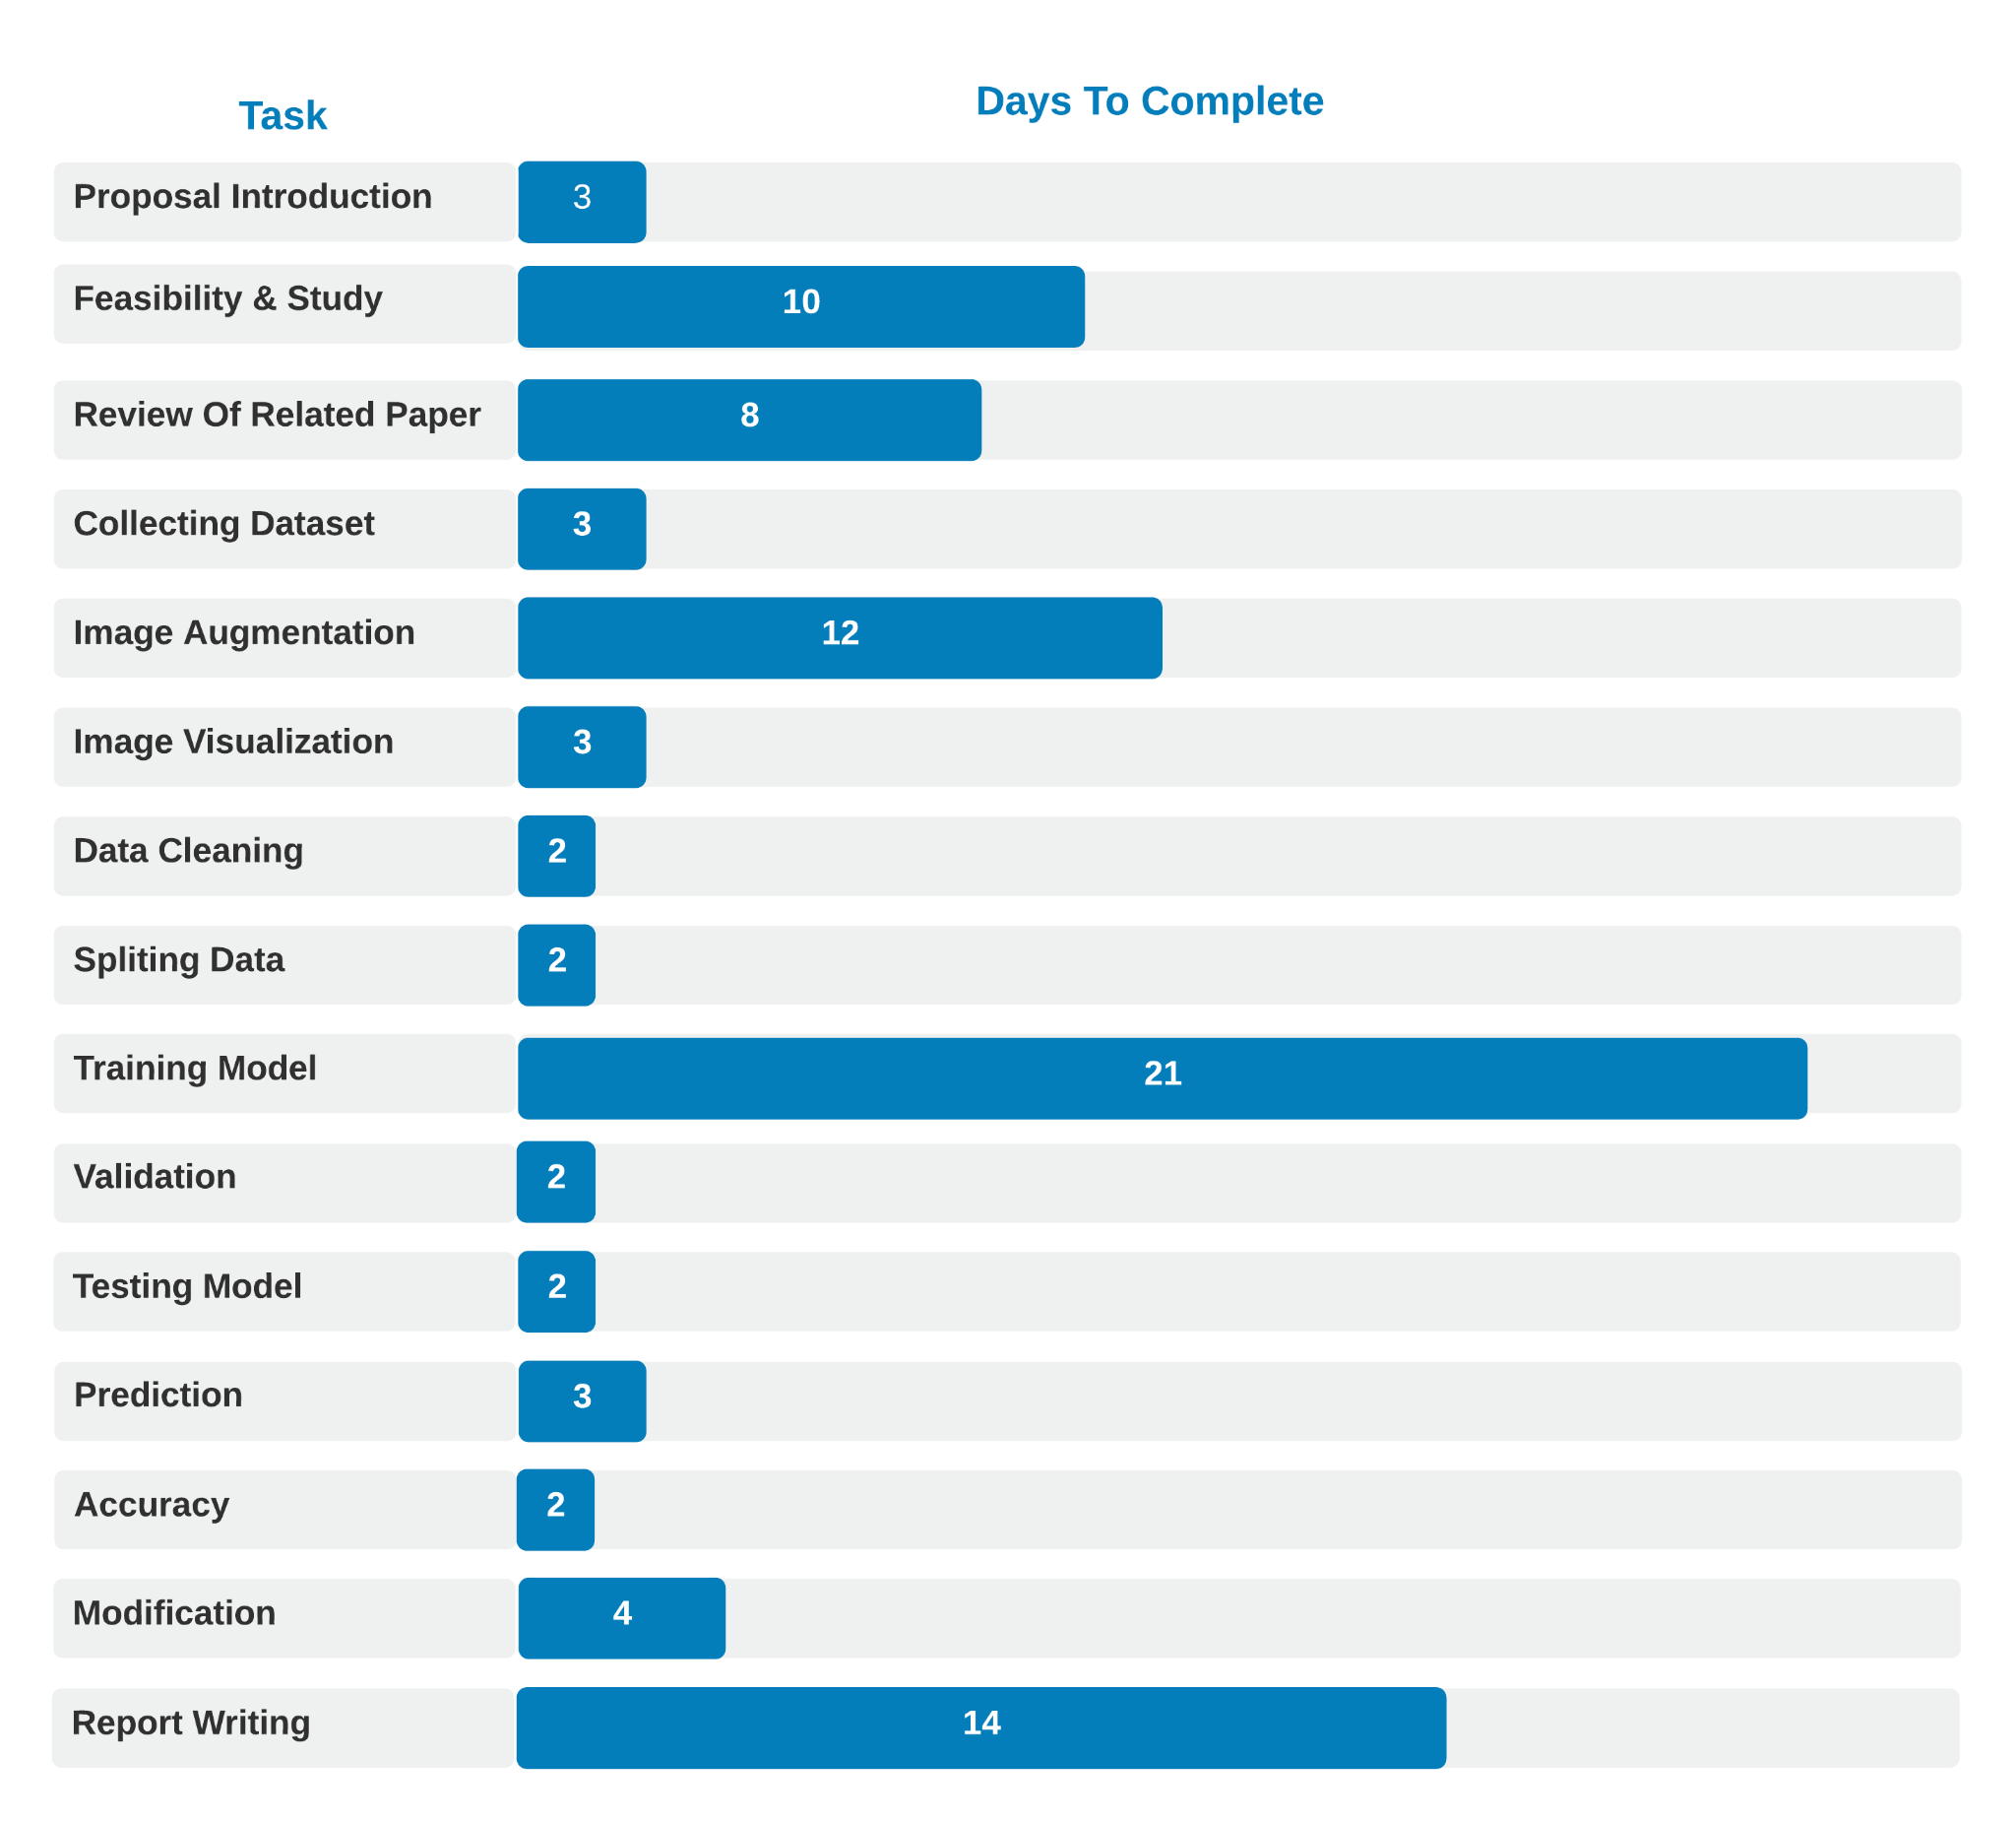
Project Timeline
Skill A
90%
Skill B
85%
Skill C
83%
Skill D
65%

Slide 17
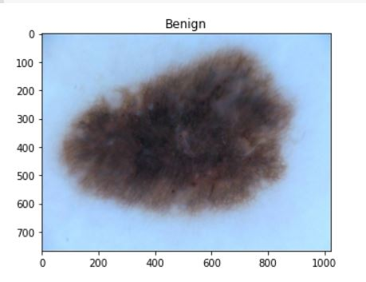
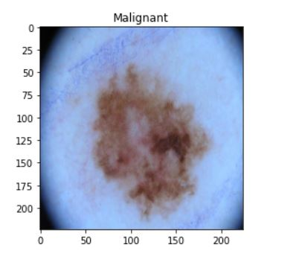
Current Progress
We have obtained a public dataset from ISIC website for skin cancer classification. We used the ISIC Archive Downloader to download the images. We used 7000 images for training (benign 3500 and malignant 3500) and 3000 images for validation of size 224 × 224. The images are distributed equally between training and validation sets which are shown below:
Figure: Random input images from ISIC dataset

Slide 18
Data Splitting
Dataset - 10000
Benign - 5000
Malignant - 5000
Train - 3500
Validation- 1500
Train - 3500
Validation- 1500

Slide 19
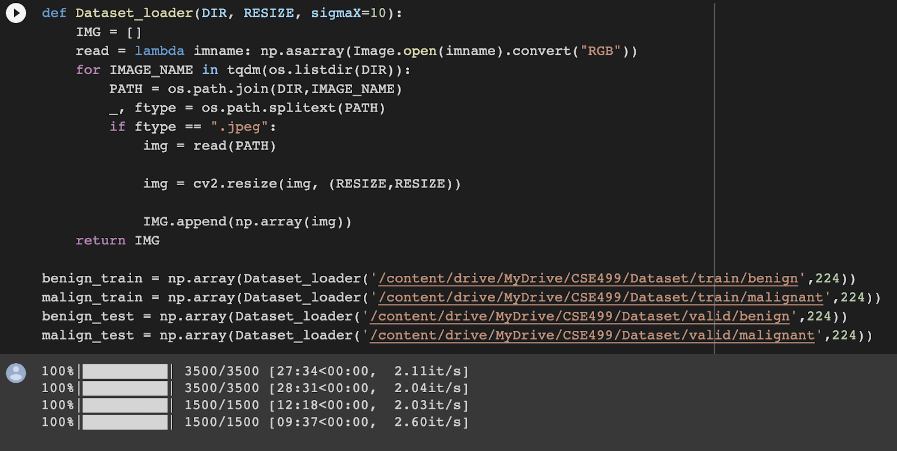
Current Progress
Image Resize
Figure: Image Resizing Code

Slide 20
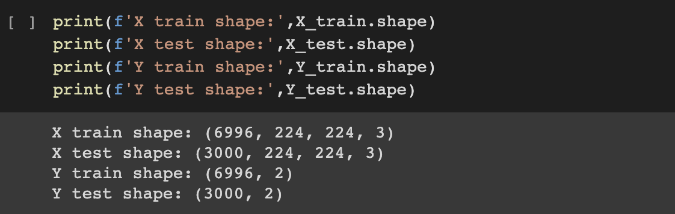
Current Progress
Image Size Result
Figure: Image Size Print Code

Slide 21
Future Work
Up until now we have completed upto ResNet50 Model Build. So, our future work is as follow
Train & test the model.
Find accuracy.
Calculate Recall & Precision.

Slide 22
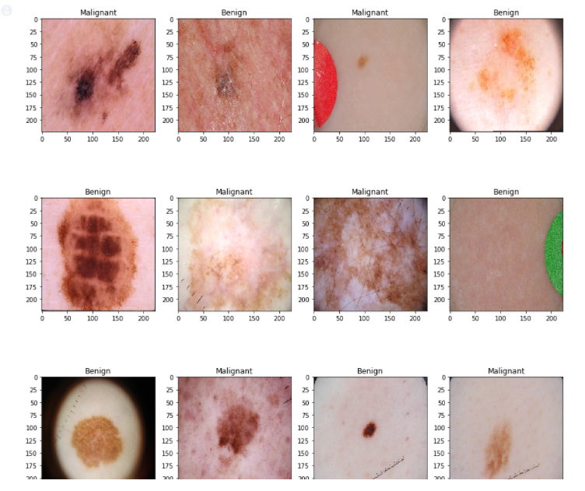
Current Progress
Final Result After Visualization
Figure:Result after visualization

Slide 23
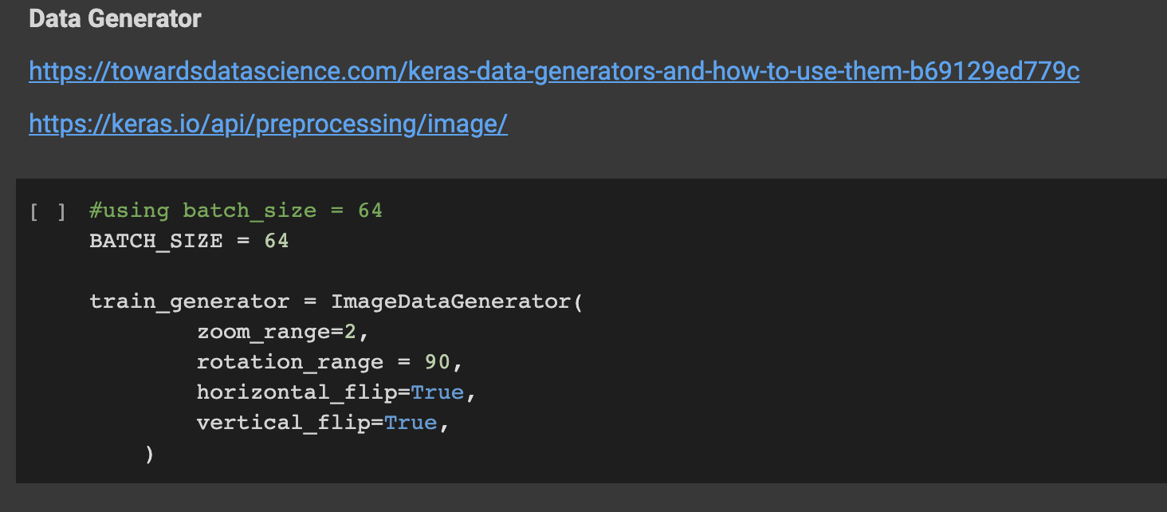
Current Progress
Used Keras Data Generator For Accuracy Improvement
Figure:Keras data generator

Slide 24
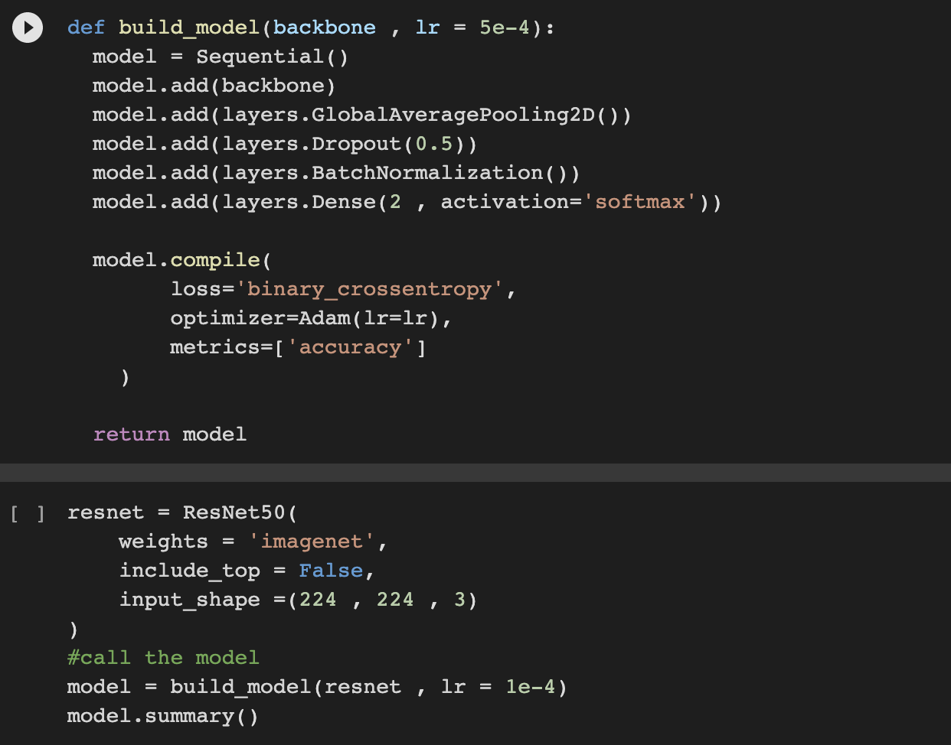
Current Progress
Then we build our ResNet50 Model
Figure: ResNet50 Model

Slide 25
Conclusion
In this project, a Convolutional Neural Networks based approach have been proposed for melanoma classification. We will develop a system that can help patients and doctors to be able to detect or identify skin cancer classes whether it is benign or malignant.
By taking some random images any doctor can identify the accurate results but in traditional approach too much time are taken to detect the cases correctly.

Slide 26
Thank you.

